Slide 1







Sport Facility & Equipment Booking System

Slide 2




Background
Integrated Sports Management Platform
Provide automate conflict detection, stock validation
Provide streamlined user journeys from login to payment for diverse consumer groups.

Slide 3

Project Planning

Slide 4

Project Team Organization
Member | Role | Email
Simon | Project Manager | kahungng9-c@my.cityu.edu.hk
Curtis | Assisstant Project Manager | whlau74-c@my.cityu.edu.hk
Paul | System Analyst | kaiwip3-c@my.cityu.edu.hk
Vincent | Programmer | kwlee232-c@my.cityu.edu.hk
Ivan | System Tester | weiyualin3-c@my.cityu.edu.hk
Tommy | Programmer | singtchan6-c@my.cityu.edu.hk

Slide 5
Development Methodology: Waterfall
Fixed Requirements: The scope is clearly defined, minimizing the risk of mid-project changes.
Linear Workflow: A straightforward, sequential approach ensures predictable control and easy monitoring of progress.
Efficiency: Given the stable scope, this method is simpler and faster to execute than iterative models like Agile.

Slide 6
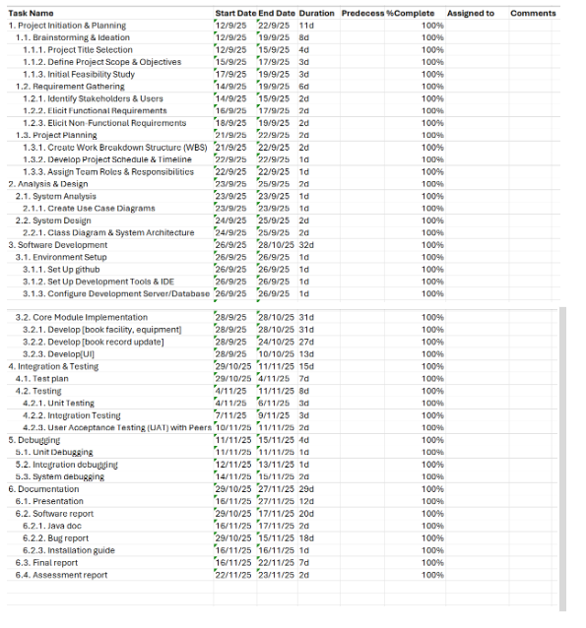
WBS
Process type WBS
Provide Clear Procedures e.g. Requirements -> Design -> Build -> Test
Provide Clearer Milestones and Gates as Major deliverables are defined by the completion of a phase

Slide 7
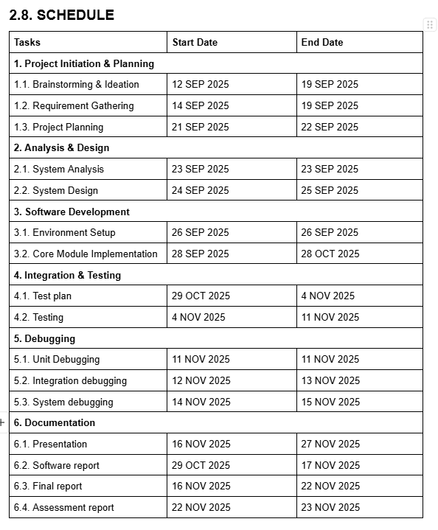
Project Schedule
80-20 Golden Rule
80% Development & Testing
20% Documentation & Planning
Coding Tasks:
Design (System Analyst) → Implmentation (Programmers) → QC & Progress tracking (PMs)

Slide 8
Resource Allocation
Limited Time & Manpower:
Assign Tasks based on strength, e.g. PMs are good at task coordination and schedule planning
Parallel Development:
Breakdown the scope into small and specific tasks with well-defined requirements and less dependency
Progress Monitoring:
PMs track task' progress frequently to allocate manpowers or task expected output modification based on project schedule

Slide 9


System Function

Slide 10
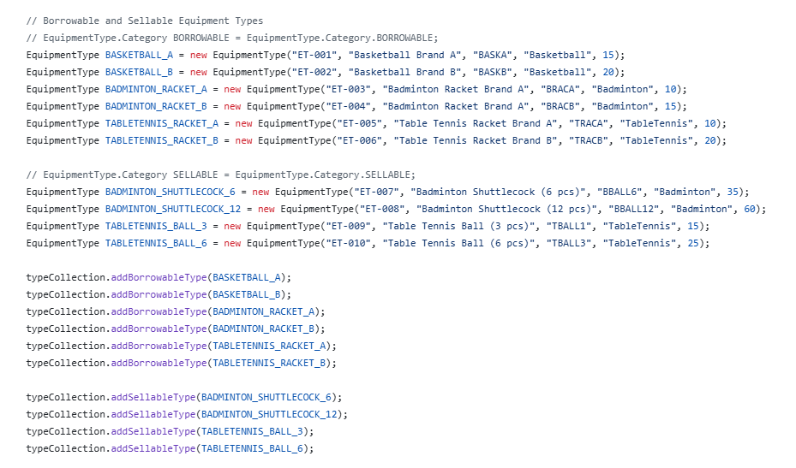
System initialization
3 equipment and 2 brands for each equipment are saved at system initially

Slide 11
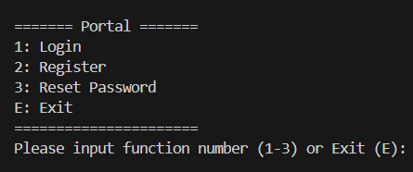
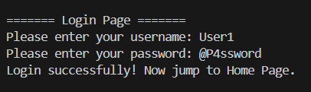
First feature: Portal
able to login, register account and reset password

Slide 12
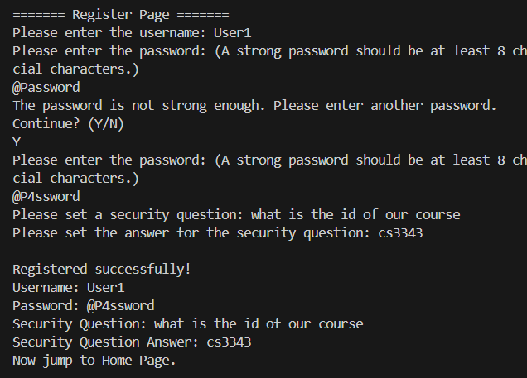
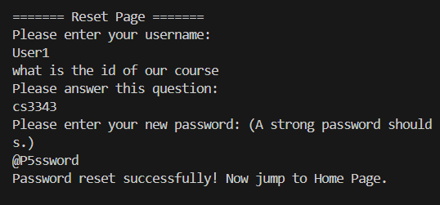
First feature: Portal
include function: password strength analysis
password is required to:
be at least the length of 8 characters
include at least one digit, uppercase, lowercase and symbol
security question for reset password

Slide 13
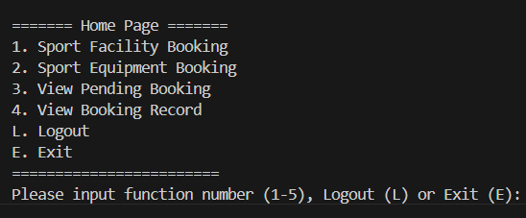
Land on Main page:

Slide 14
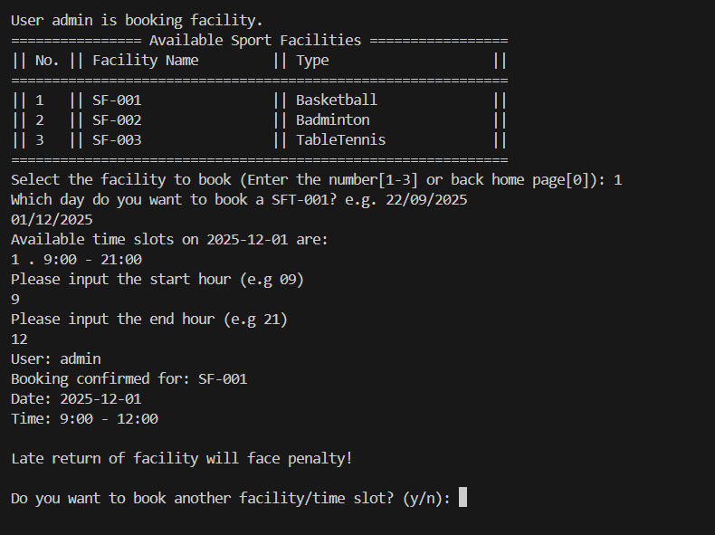
Second Feature: Book Facility
List all available facility no., facility name and type in a table
User can input corresponding function number to choose facility

Slide 15
Second Feature: Book Facility
Display the available time period for the date you chosen
Confirmation message after booking

Slide 16
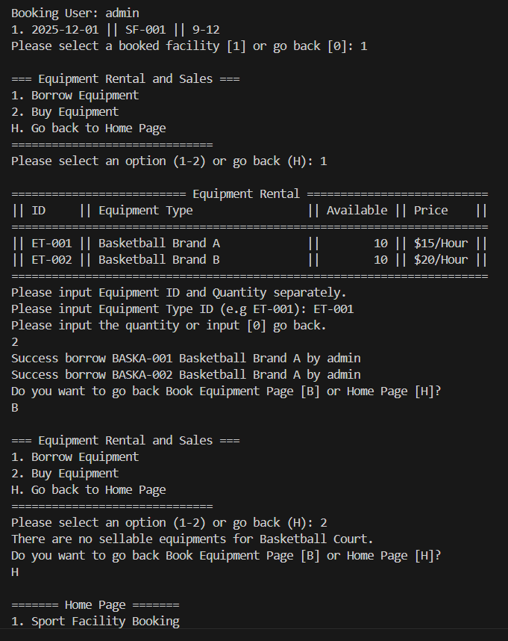
Third Feature: Borrow/Sell Equipment
User can borrow/buy corresponding equipment if he has facility booking
List all equipment id, equipment type, available status and price per hour in a table corresponding to your booked facility

Slide 17
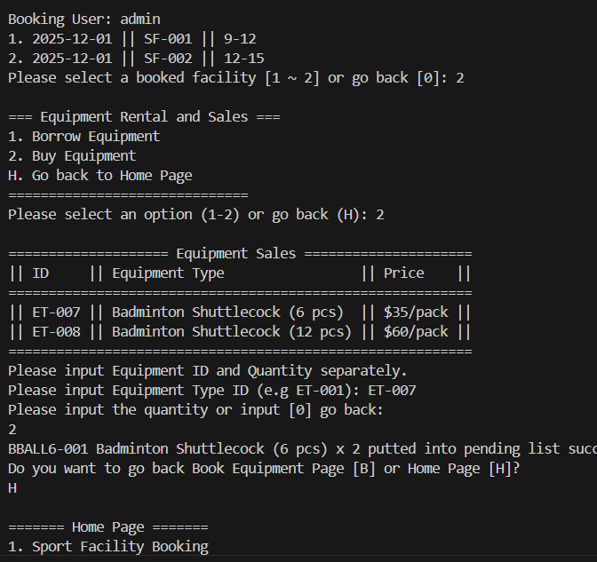
Third Feature: Borrow/Sell Equipment
User can purchase equipment also

Slide 18
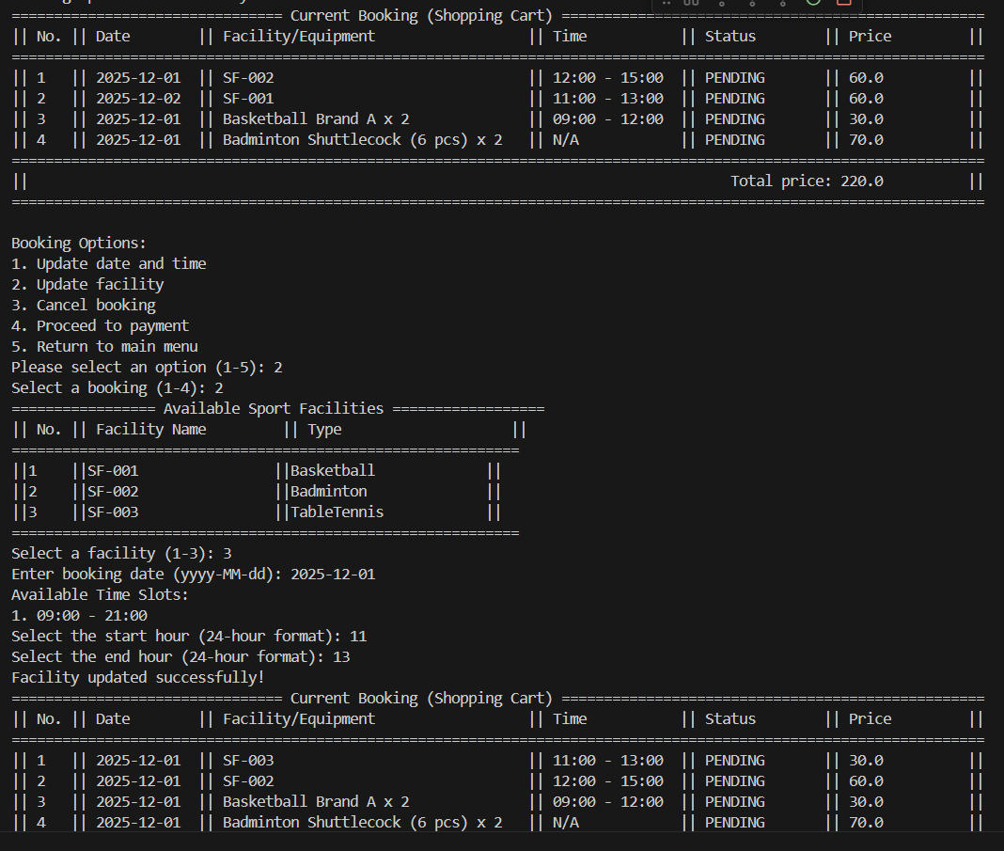
Fourth Feature: view current booking (Shopping cart)
update booking date and time before booking date

Slide 19
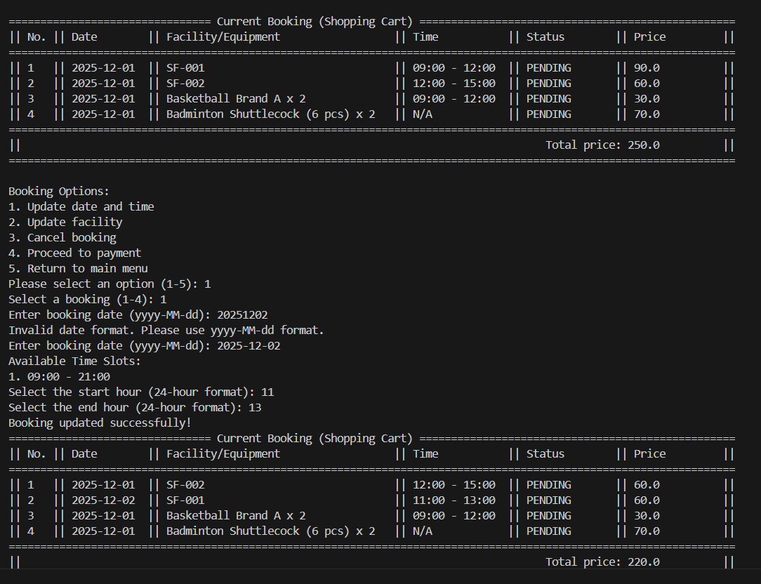
Fourth Feature: view current booking (Shopping cart)
User can view all the pending booking in view current booking screen
update booking facility/Equipment before booking date

Slide 20
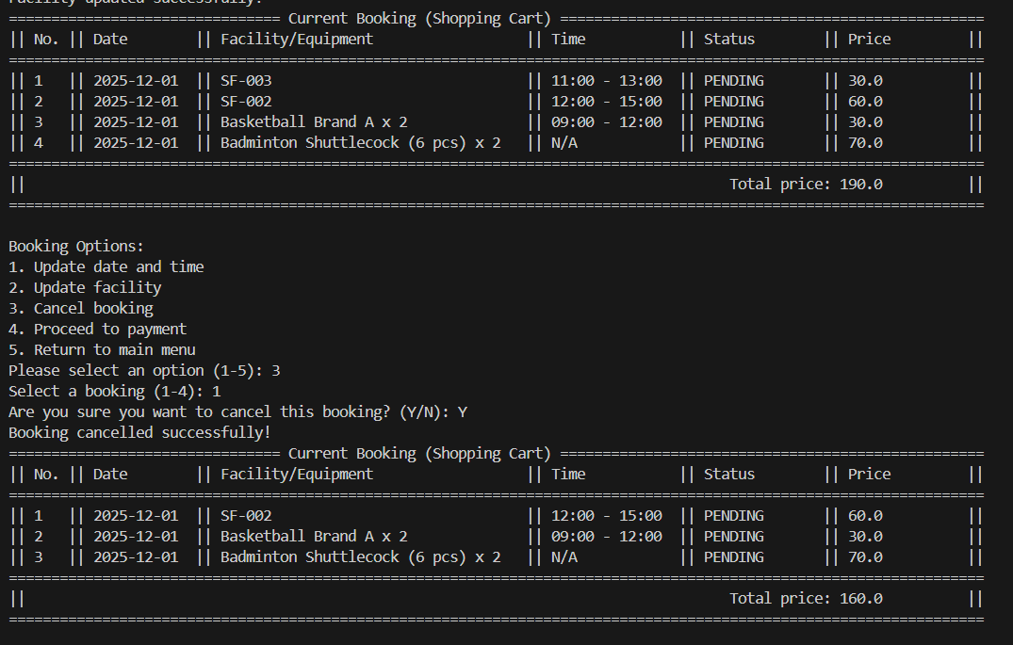
Fourth Feature: view current booking (Shopping cart)
cancel booking before booking time

Slide 21
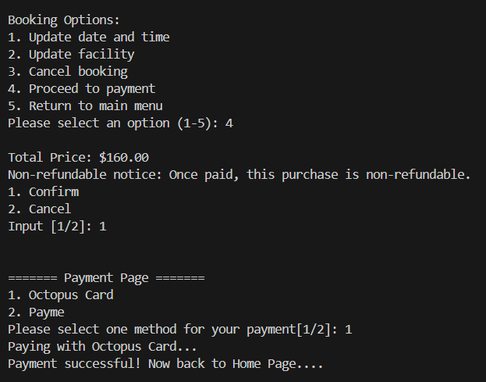
Fifth Feature: Payment
Sum all prices of items in shopping cart and return the total price
discount price for those gold/platinum membership (20% and 40% off respectively)

Slide 22
Fifth Feature: Payment
Options for paying with Octopus or payme (Imaginary)
Message will be sent after paid successfully

Slide 23
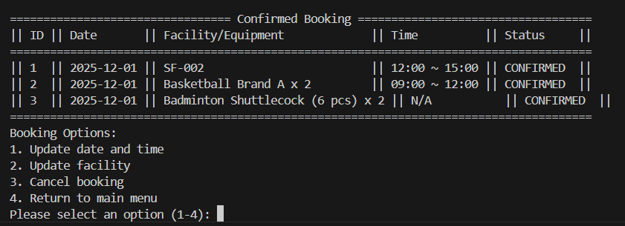
Sixth Feature: view confirmed booking
User can view all the confirmed booking in view current booking screen
Similar function with view current booking

Slide 24
System Design

Slide 25
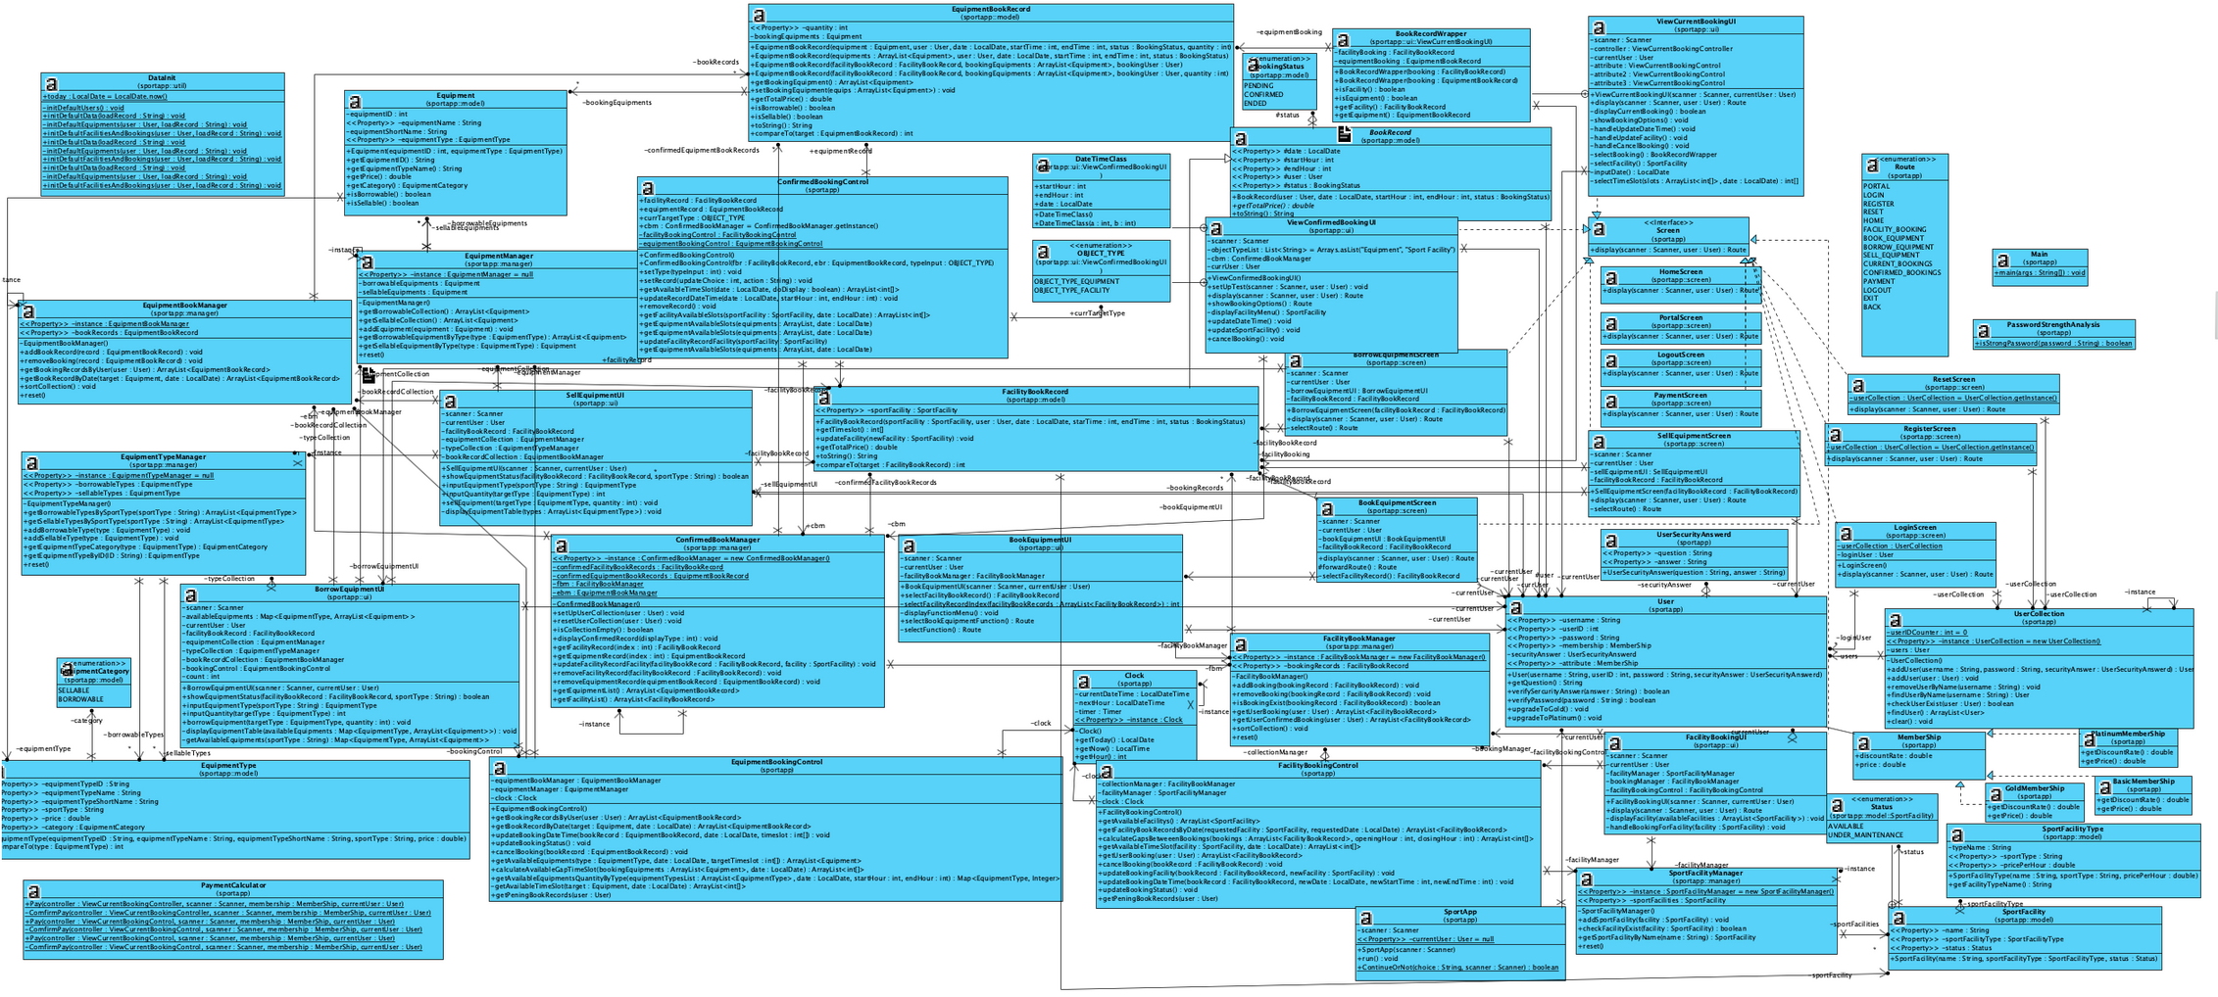
Overall Class Diagram

Slide 26
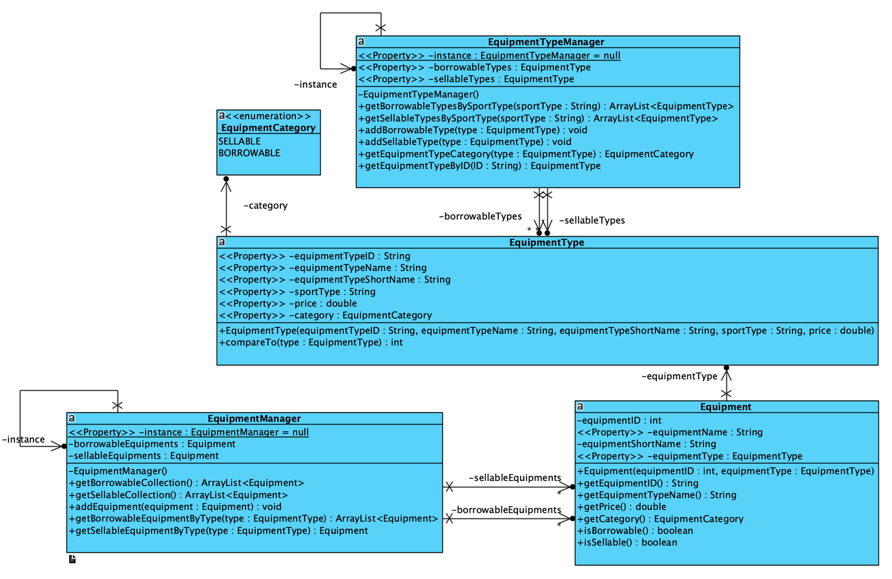
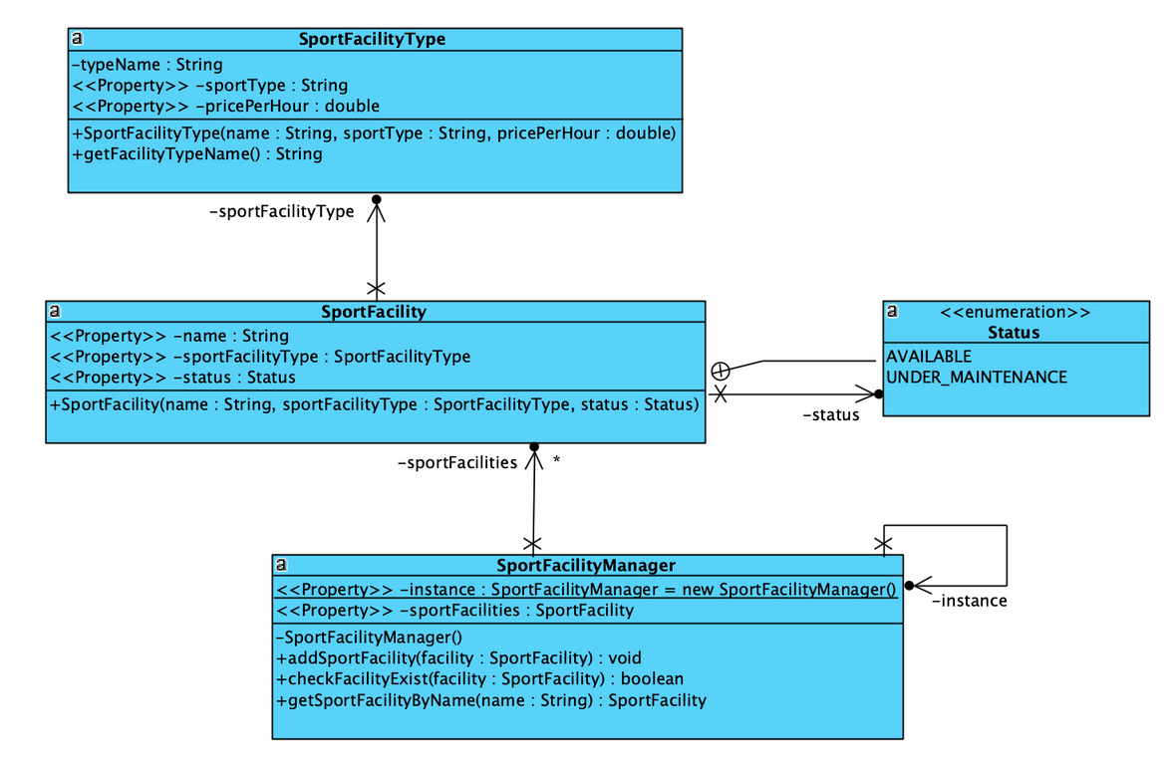
Equipment and Facilities

Slide 27
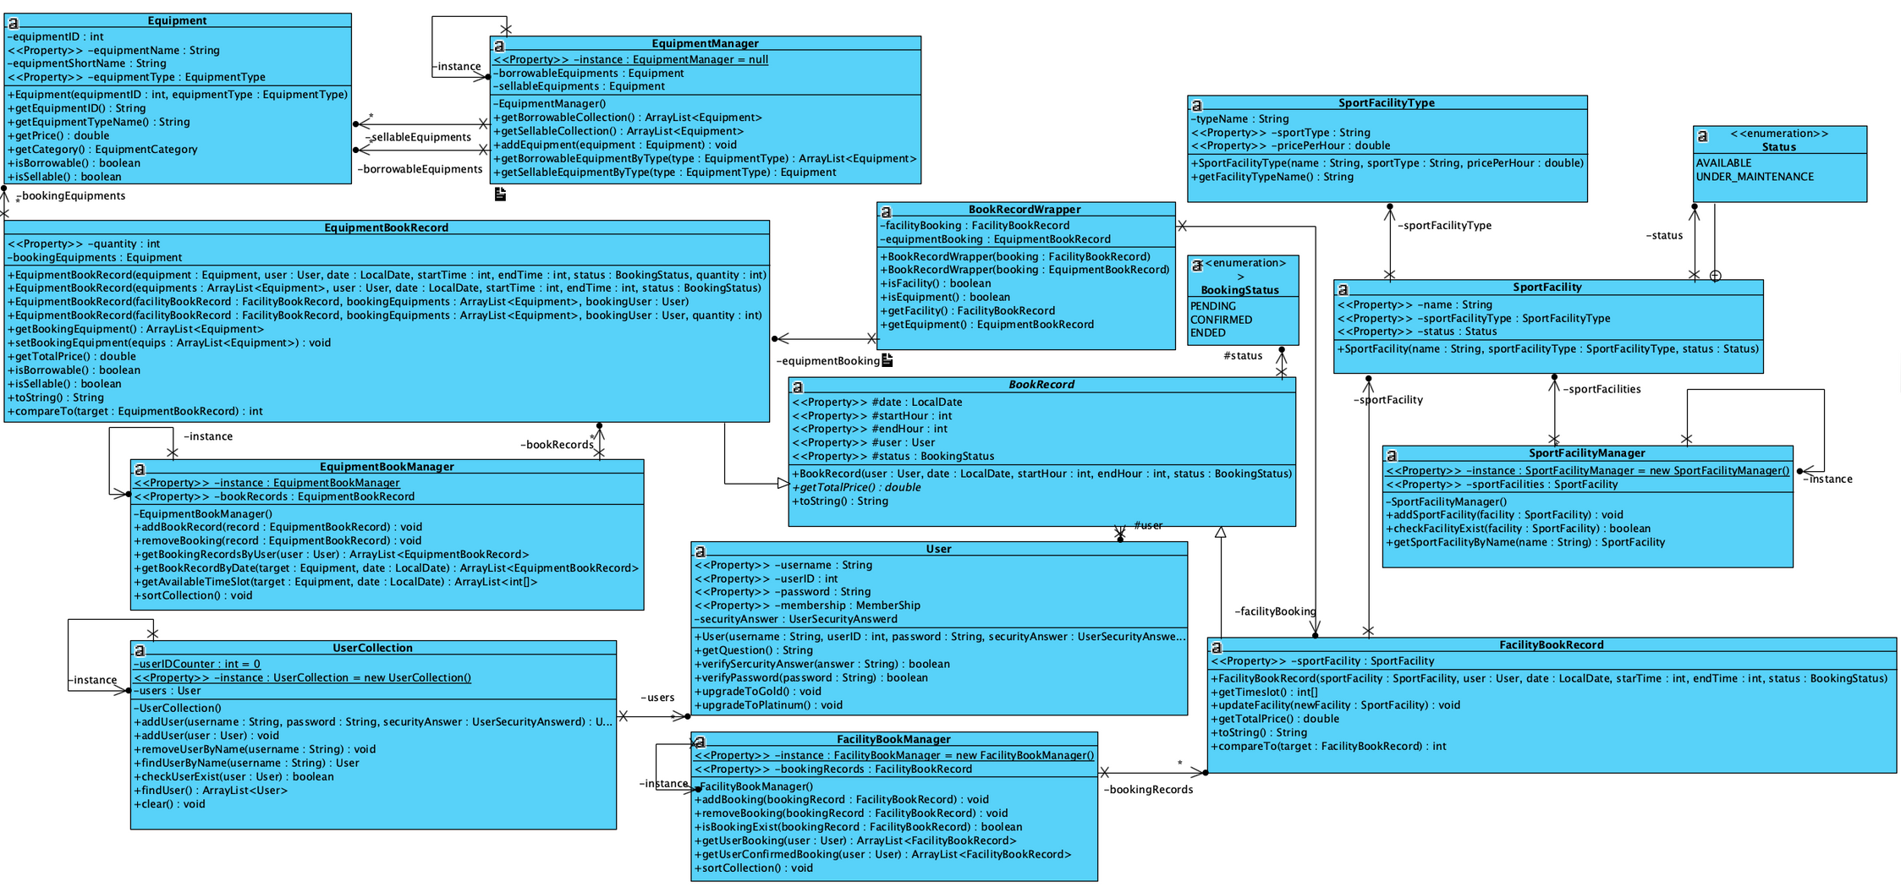
Book Record

Slide 28
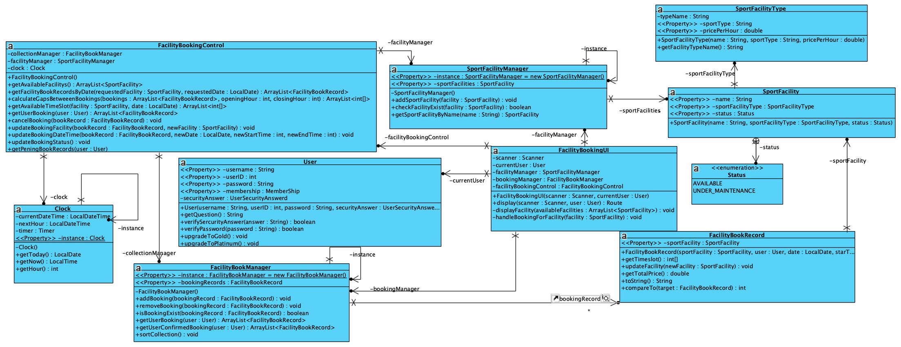
Book Facility

Slide 29
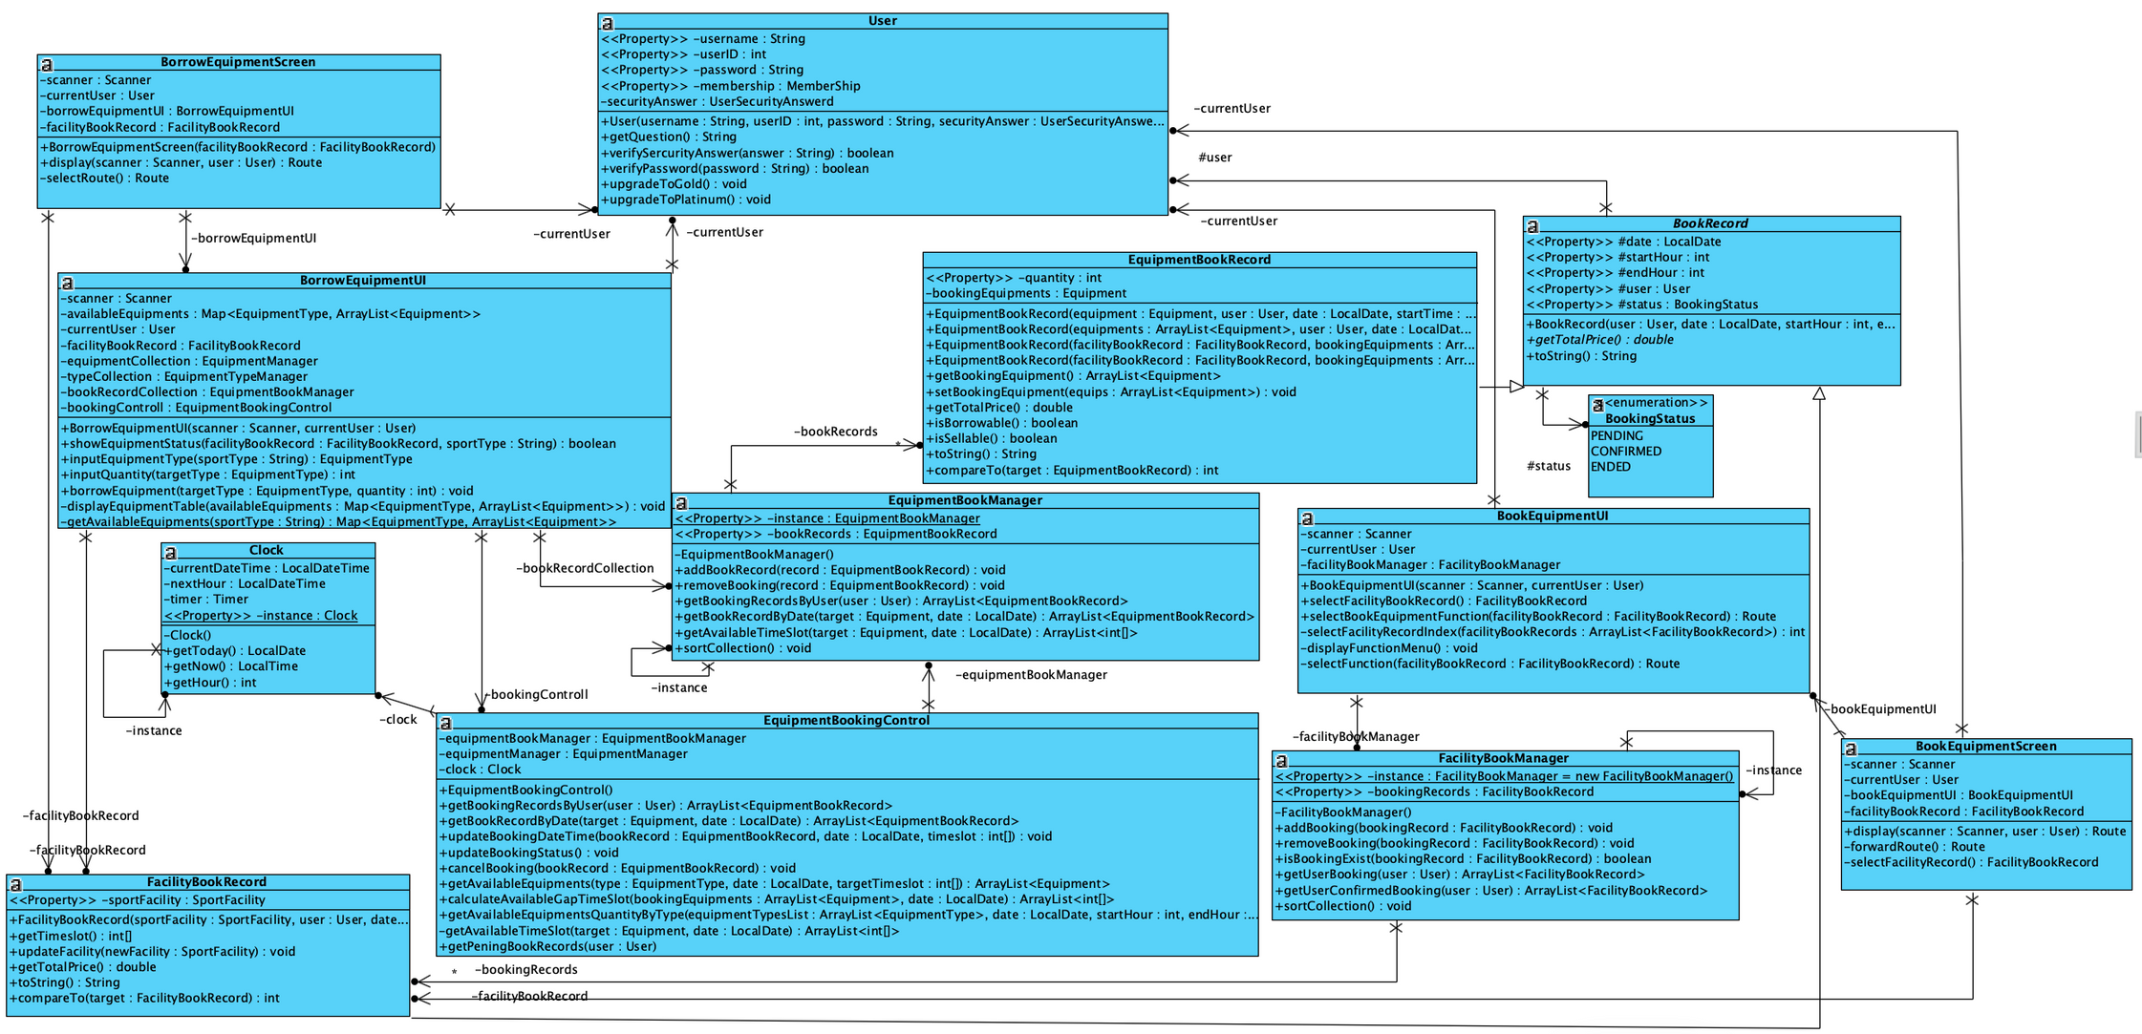
Borrow Equipment

Slide 30
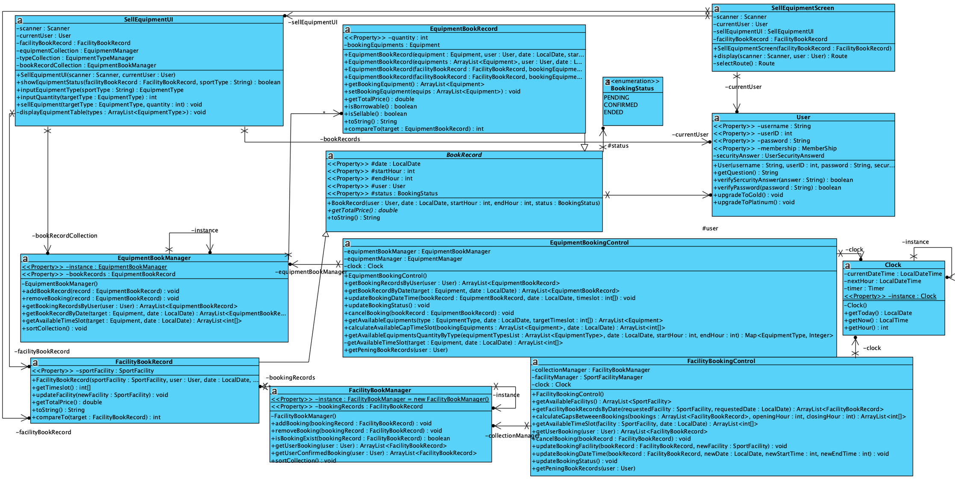
Buy Equipment

Slide 31
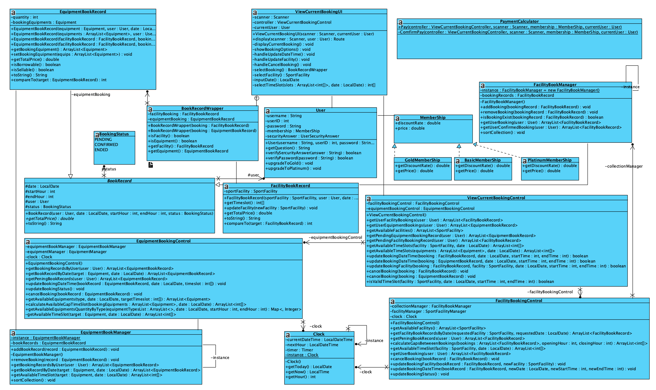
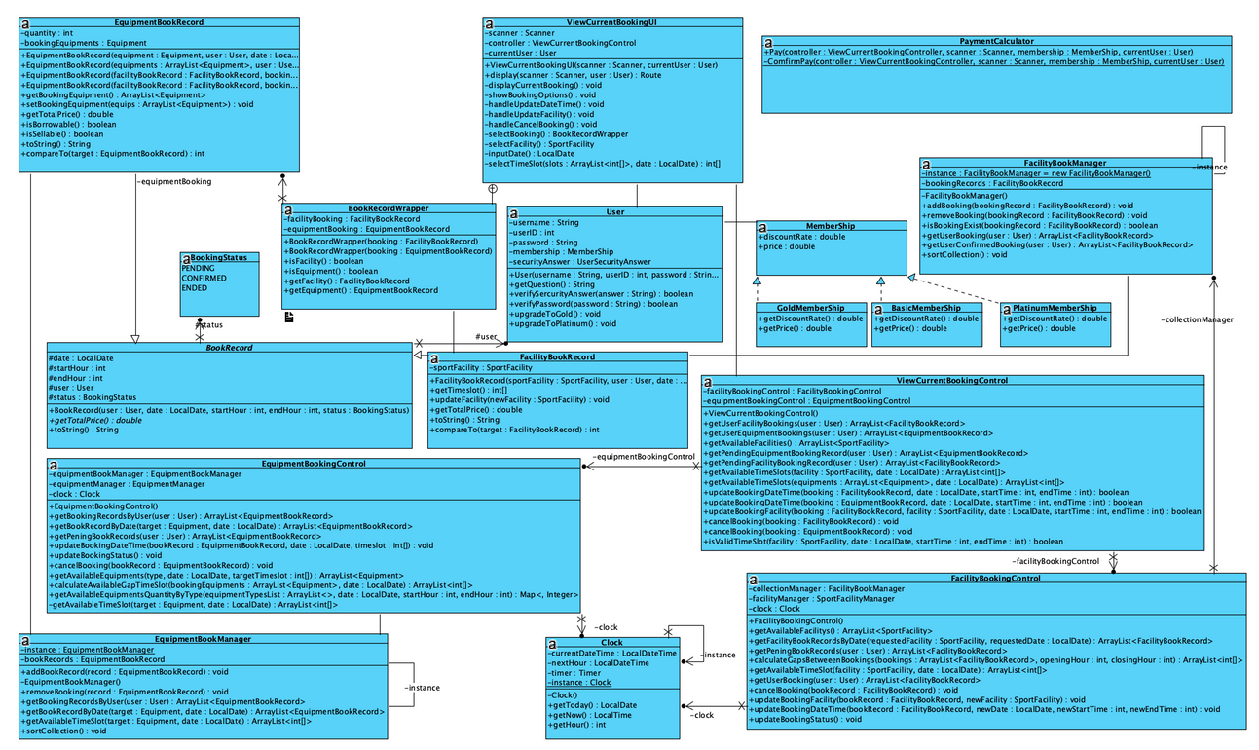
View Current Record

Slide 32
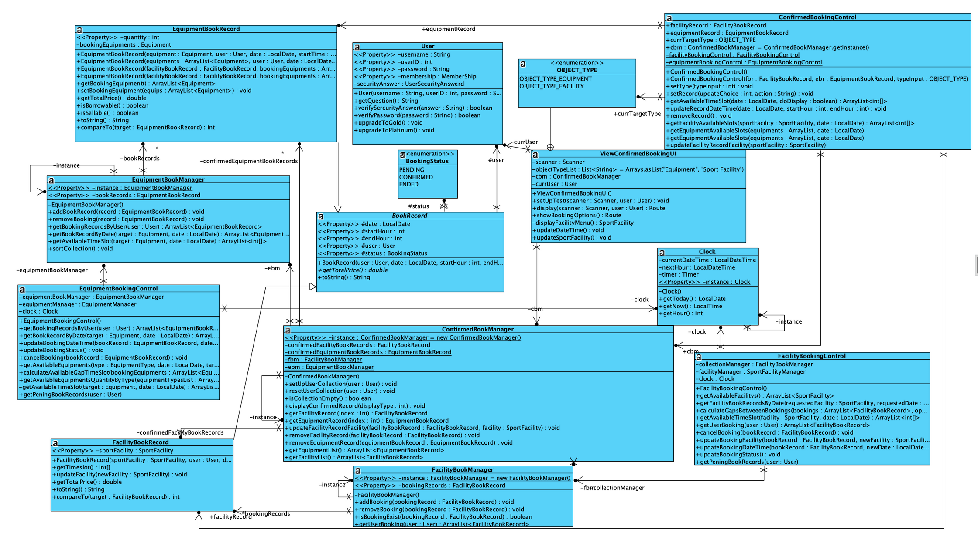
View Confirmed Record

Slide 33
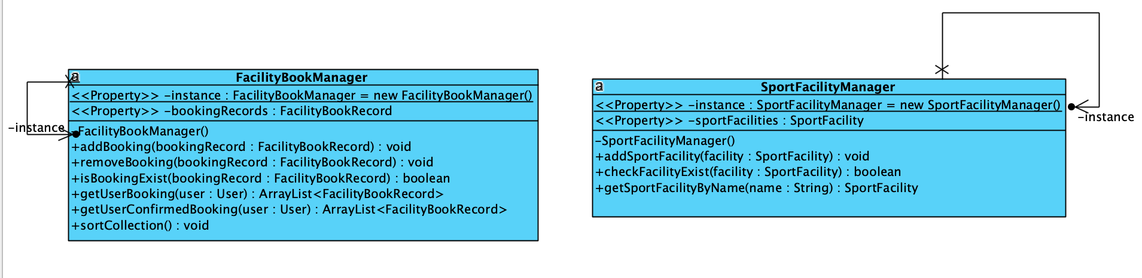
Design Pattern - Singleton
Singleton → ensure only one class only exist during the run
using the pattern in important classes
Prevent error caused by data inaccuracy and data asymmetry
Example: Manager classes → Record and data related classes

Slide 34
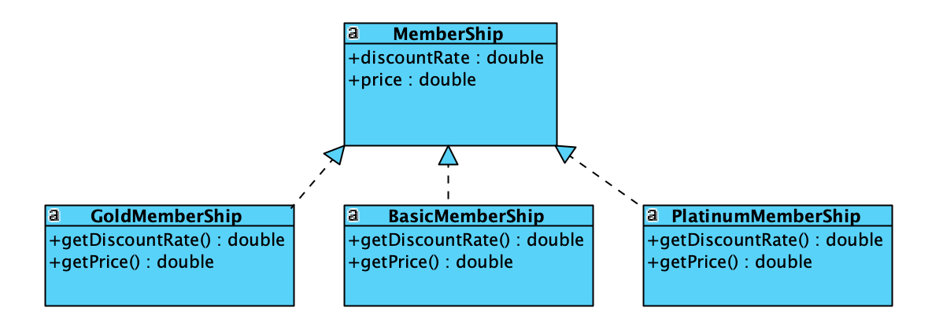
Design Pattern - State Pattern
Utilizing state pattern so that behaviours of class pattern can be easily modified.
Example: Different Memberships

Slide 35
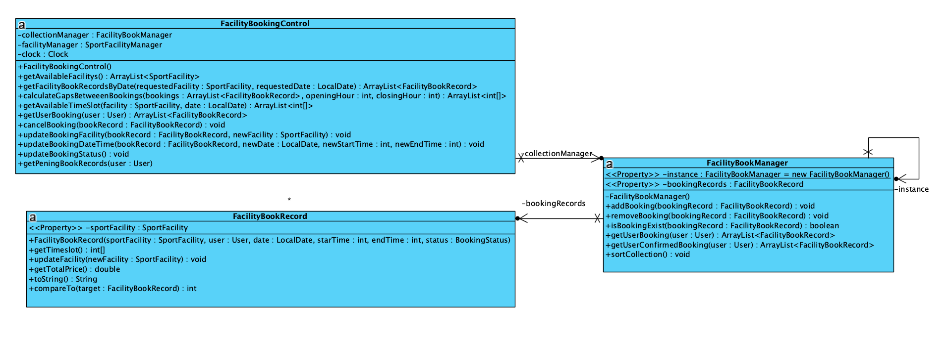
Design Principles - SRP
Single Responsibility should only be applied on each class. For example, facility book record has a collection store in facilityBookManager, related control on facility book record is done in faciltyBookControl

Slide 36
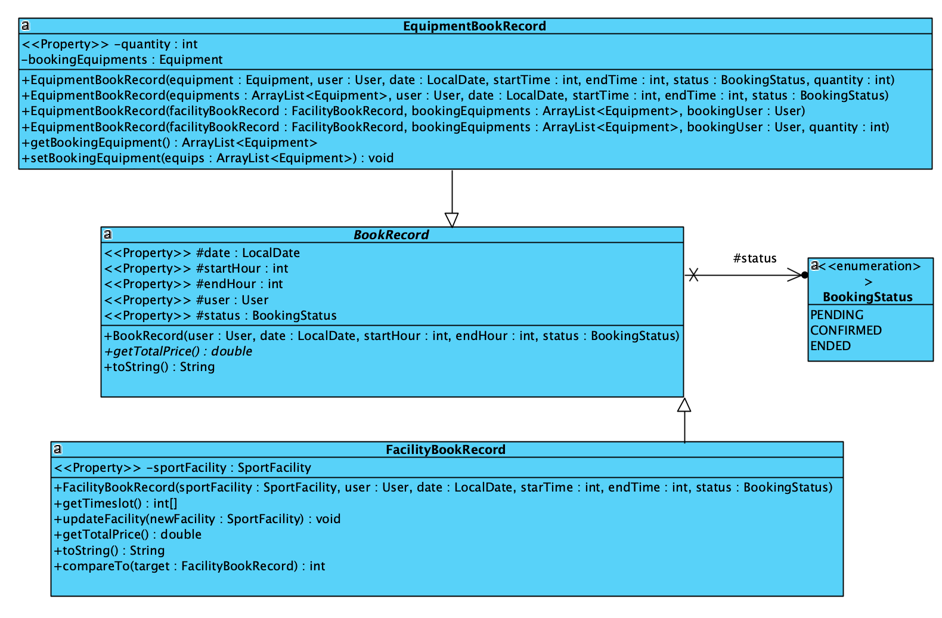
Design Principles - OCP
Both equipmentBookRecord and faciltiyBookRecord has a super class bookRecord.
open for extension (specified function defined in subclass),
closed for modifications (abstraction defined in superclass)

Slide 37
Code
Refactoring

Slide 38
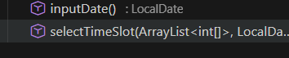
EXTRACT METHOD
Duplicate code
to ask for input
Reusable methods

Slide 39
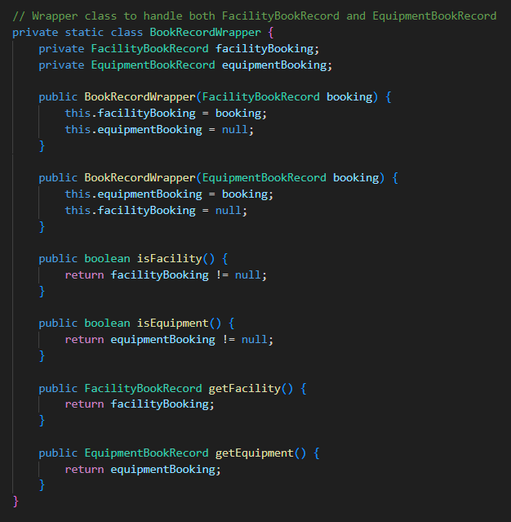
EXTRACT CLASS

Slide 40
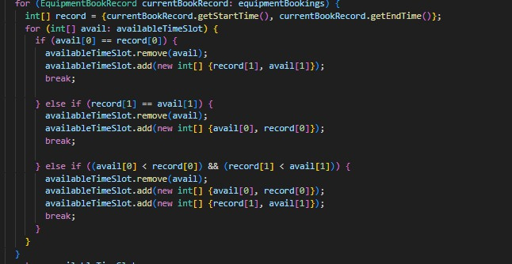
SUBSTITUTE METHOD
So many if

Slide 41
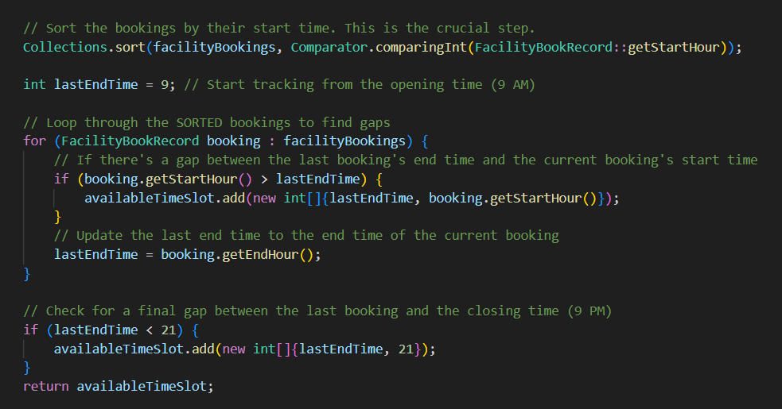
SUBSTITUTE METHOD
easier to understand logic

Slide 42
Project
Configration

Slide 43



Development

Slide 44



IDE choosing
Lite weight
user friendly interface
for creating test

Slide 45
Bug Report

Slide 46
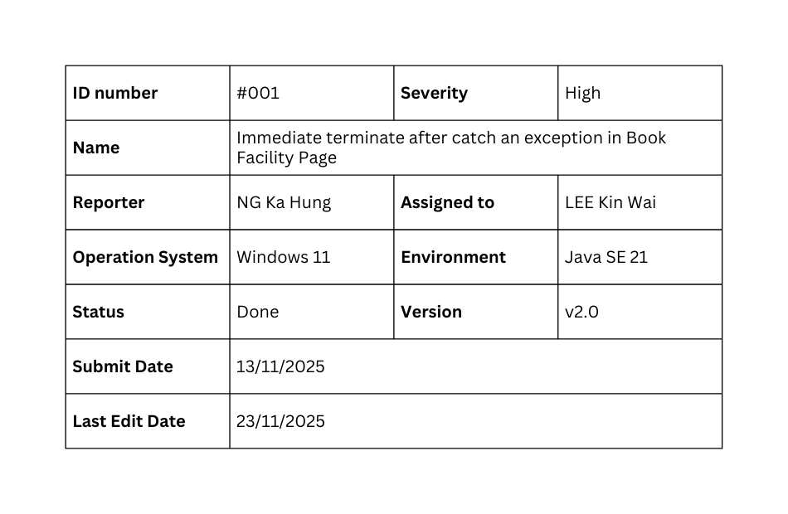
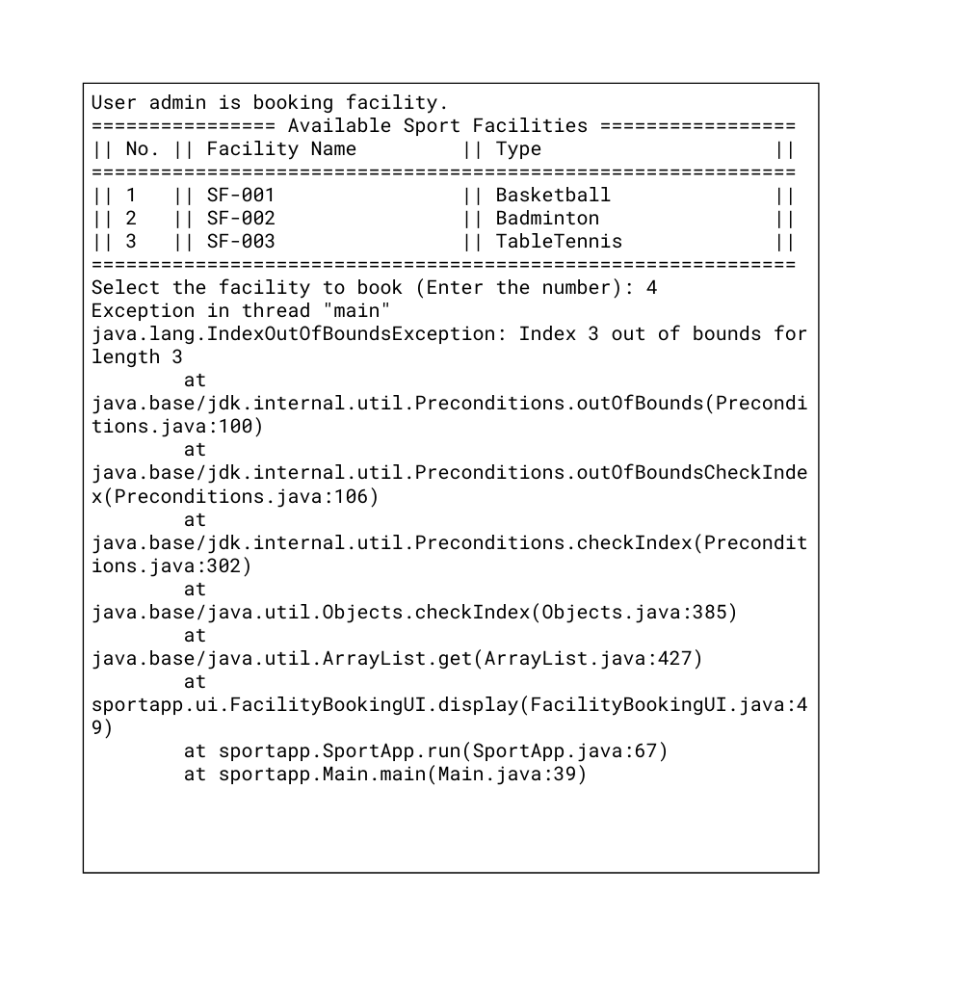
Bug Report - #001
Steps to reproduce
> Login
> Select “1” in Home page
> input data with incorrect format or type
> an exception throw out and crash immediately
Expected result
The program should keep asking repeatedly until the user inputs a valid input, and allow the user to input “0” to escape the loop.
Actual result
Exception throwed and crashed immediately.

Slide 47
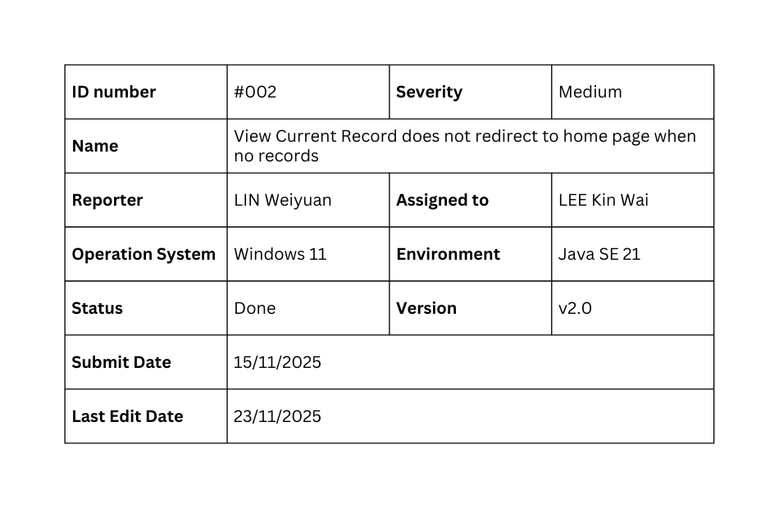
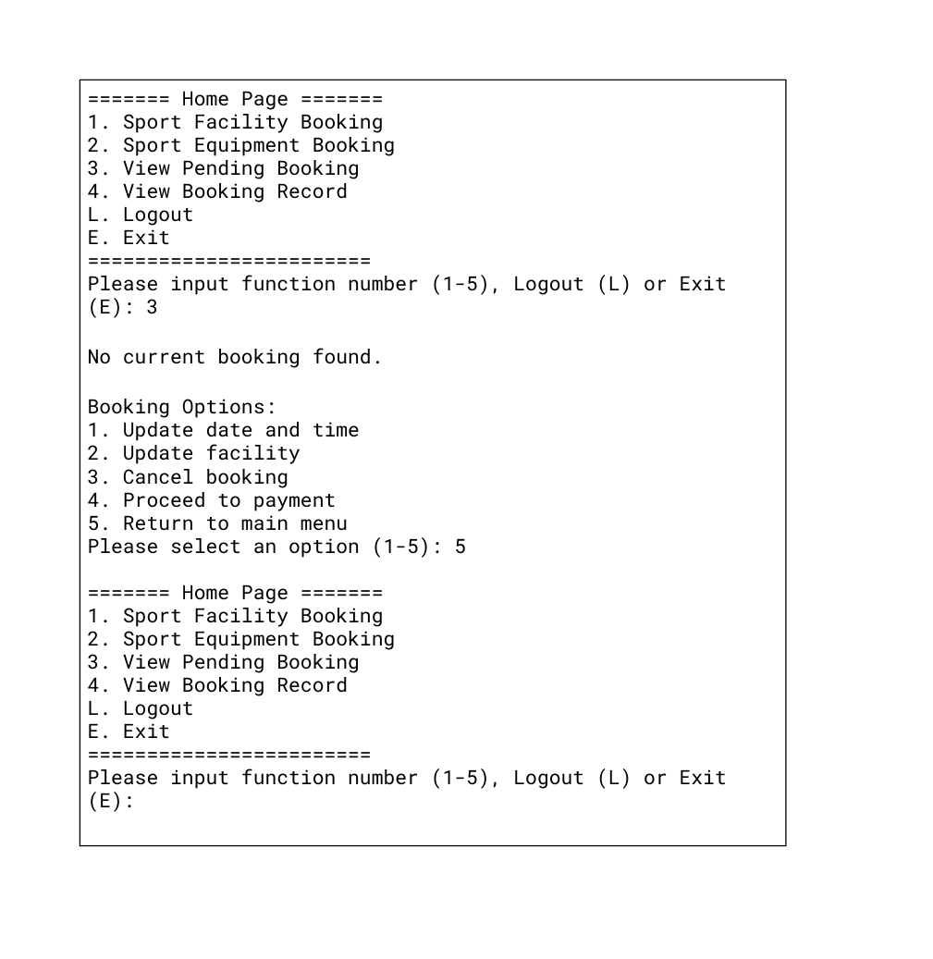
Bug Report - #002
Steps to reproduce
> Login
> Select “3” in Home Page,
> and enter View Current Booking Page
Expected result
The program should display the line “No current booking found.”, and redirect back to the Home page automatically.
Actual result
“No current booking found.” and Option menu of view current booking page have shown.

Slide 48
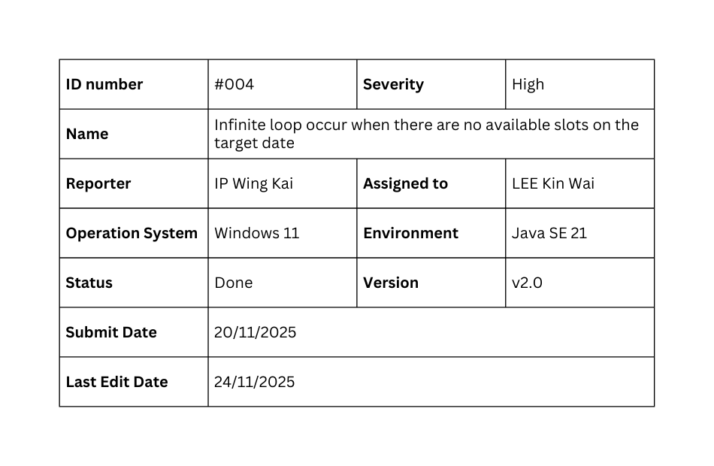
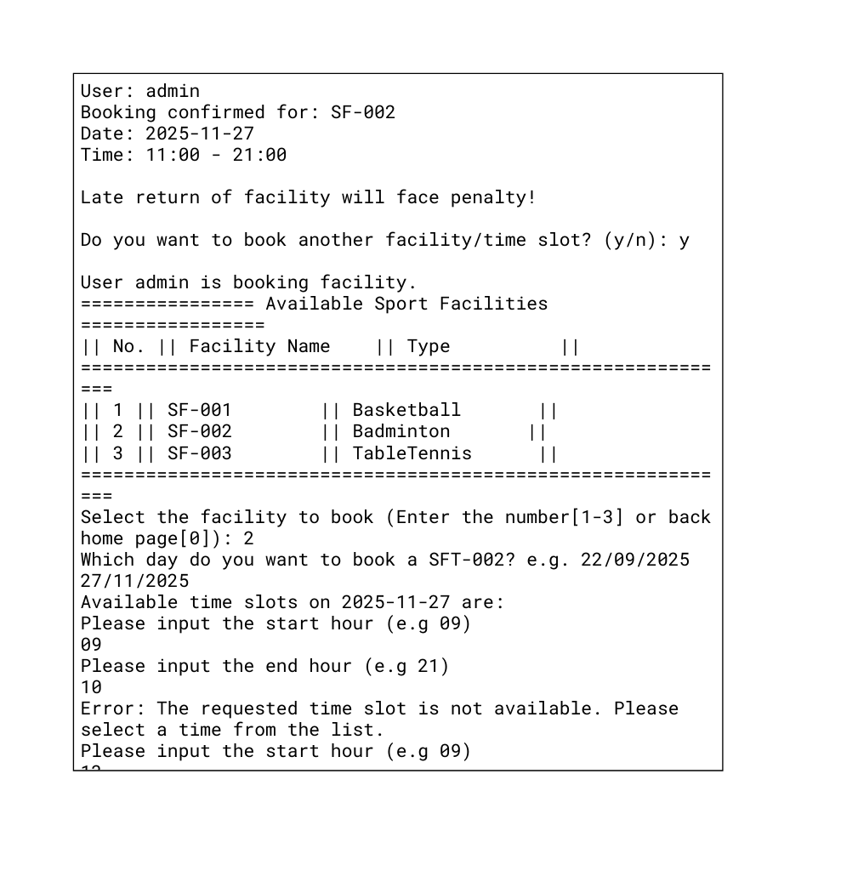
Bug Report - #004
Steps to reproduce
> Login
> Select “1” in Home page
> Select one facility, and make bookings for all available timeslots,
> and make a booking for that facility again.
Expected result
The program should display the line “Sorry, there are no available slot for that day..”.
Actual result
An infinite loop occurs as the program keeps asking the user for the start hour and end hour of the booking.

Slide 49
Testing

Slide 50
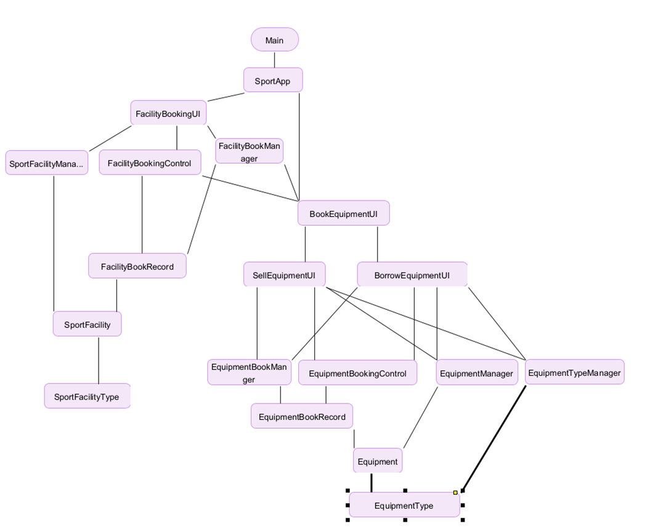
Hierarchy of Program Modules

Slide 51
Bottom-up Approach
Advantages
Builds a strong foundation – ensures lower-level modules are reliable before testing higher layers
Early bug detection – catches logic errors in core components early
Encourages reusability – tested components can be safely reused across the system
Independent of UI – testing can begin early without waiting for interfaces
DO NOT NEED STUB

Slide 52
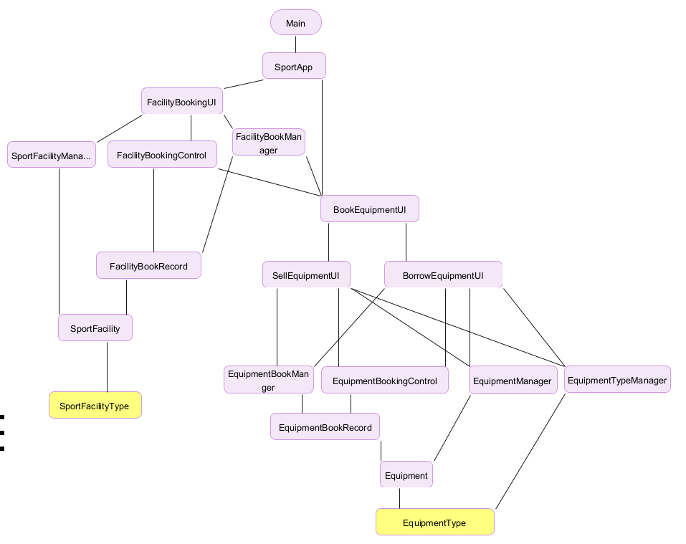
Testing Process
Unit Test:
SportFacilityType
EquipmentType

Slide 53
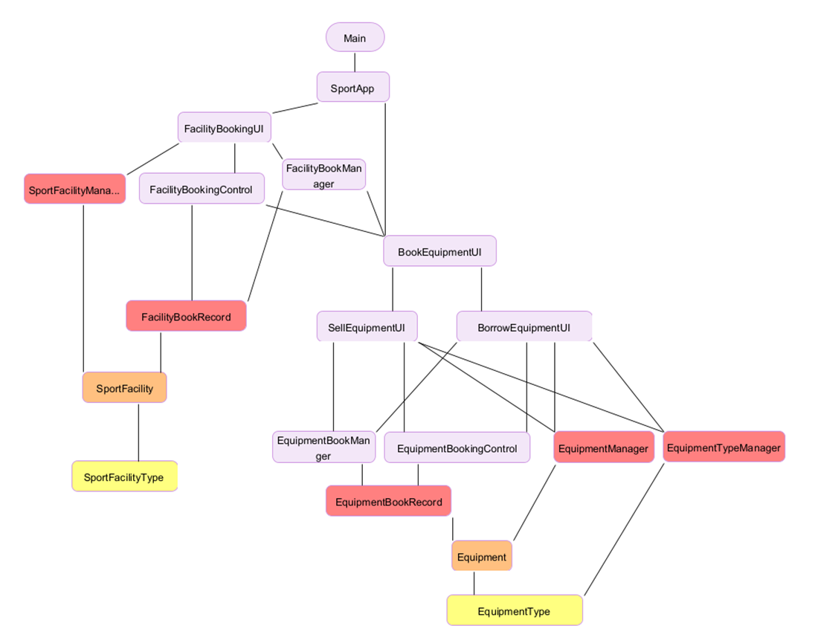
Testing Process
Integration Testing:
SportFacility + Equipment + SportFacilityType + EquipmentType
(Test Stub:N/A)
SportFacility + Equipment + SportFacilityType + EquipmentType + EquipmentBookRecord + EquipmentManager + EquipmentTypeManager + FacilityBookRecord + SportFacilityManager (Test Stub: N/A)

Slide 54
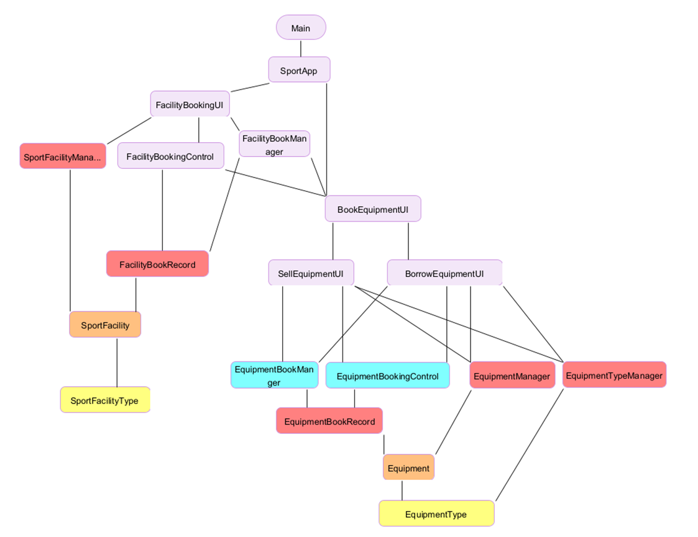
Testing Process
Integration Testing:
EquipmentBookManager + EquipmentBookingControl+ portFacility + Equipment + SportFacilityType + EquipmentType + EquipmentBookRecord + EquipmentManager + EquipmentTypeManager + FacilityBookRecord + SportFacilityManager (Test Stub: N/A)

Slide 55
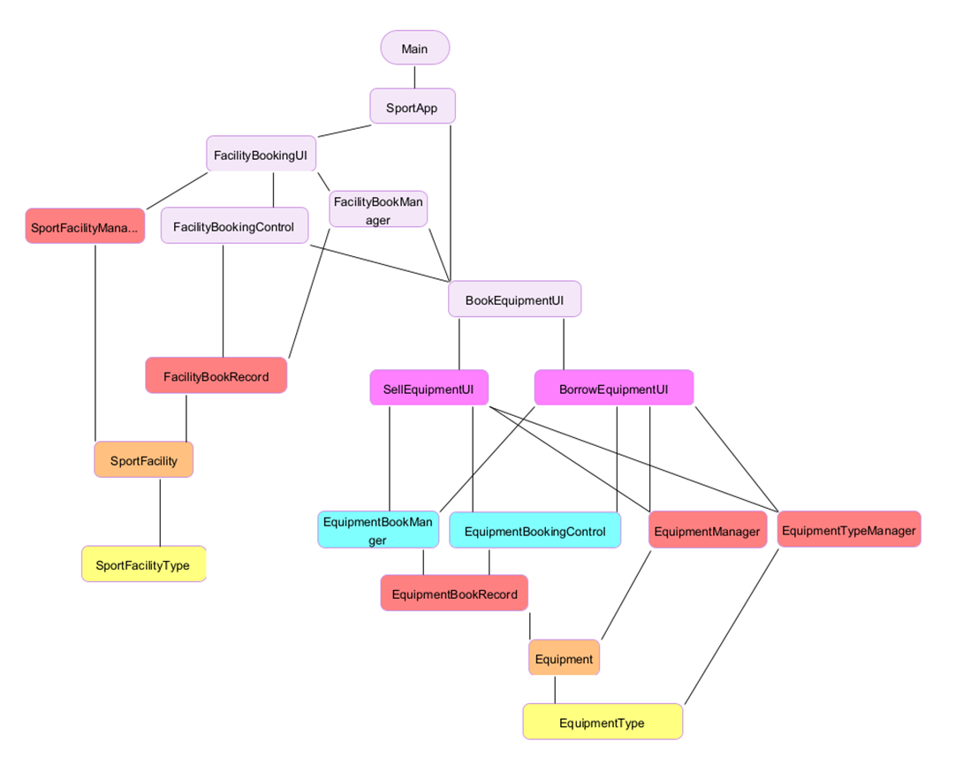
Testing Process
Integration Testing:
SellEquipmentUI + BorrowEquipmentUI + EquipmentBookManager + EquipmentBookingControl+ portFacility + Equipment + SportFacilityType + EquipmentType + EquipmentBookRecord + EquipmentManager + EquipmentTypeManager + FacilityBookRecord + SportFacilityManager (Test Stub: N/A)

Slide 56
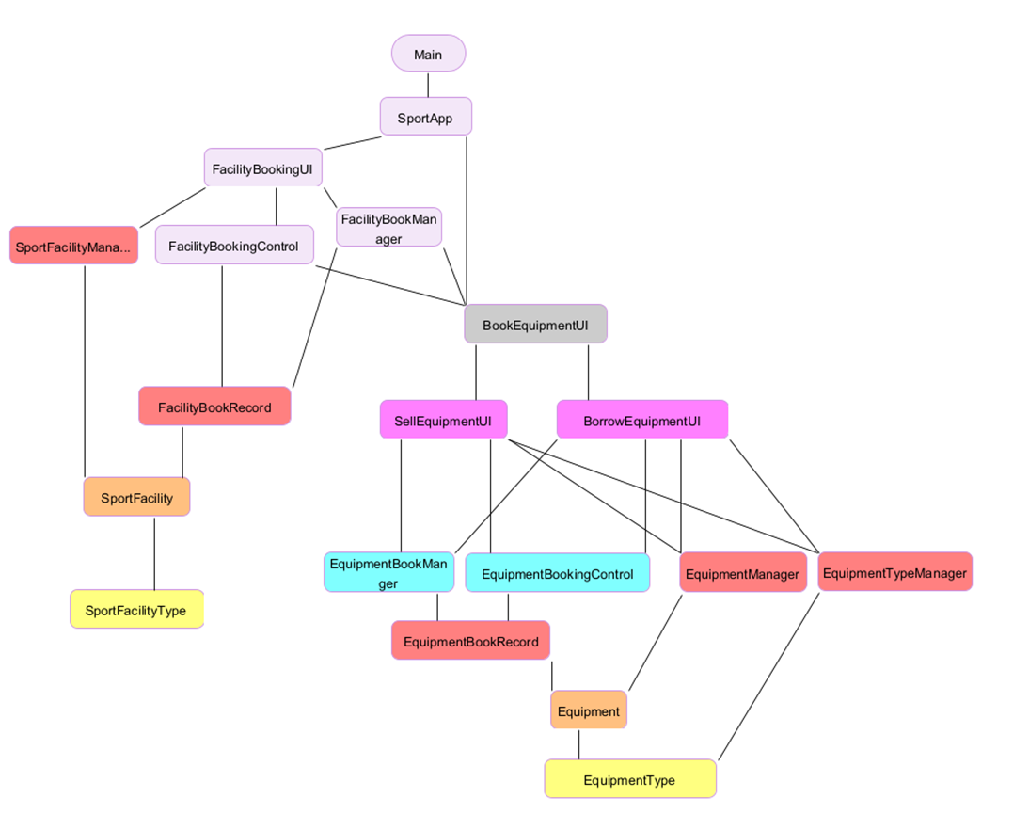
Testing Process
Integration Testing:
BookEquipmentUI + SellEquipmentUI + BorrowEquipmentUI + EquipmentBookManager + EquipmentBookingControl+ portFacility + Equipment + SportFacilityType + EquipmentType + EquipmentBookRecord + EquipmentManager + EquipmentTypeManager + FacilityBookRecord + SportFacilityManager (Test Stub: N/A)

Slide 57
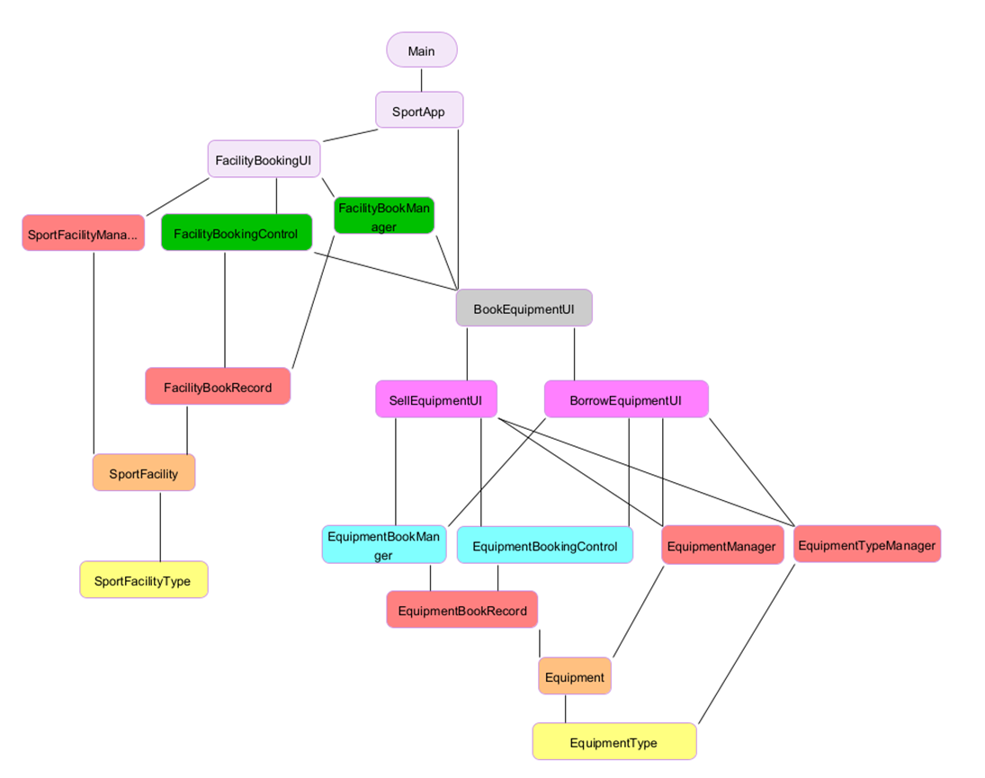
Testing Process
Integration Testing:
FacilityBookingControl + FacilityBookManager +BookEquipmentUI + SellEquipmentUI + BorrowEquipmentUI + EquipmentBookManager + EquipmentBookingControl+ portFacility + Equipment + SportFacilityType + EquipmentType + EquipmentBookRecord + EquipmentManager + EquipmentTypeManager + FacilityBookRecord + SportFacilityManager (Test Stub: N/A)

Slide 58
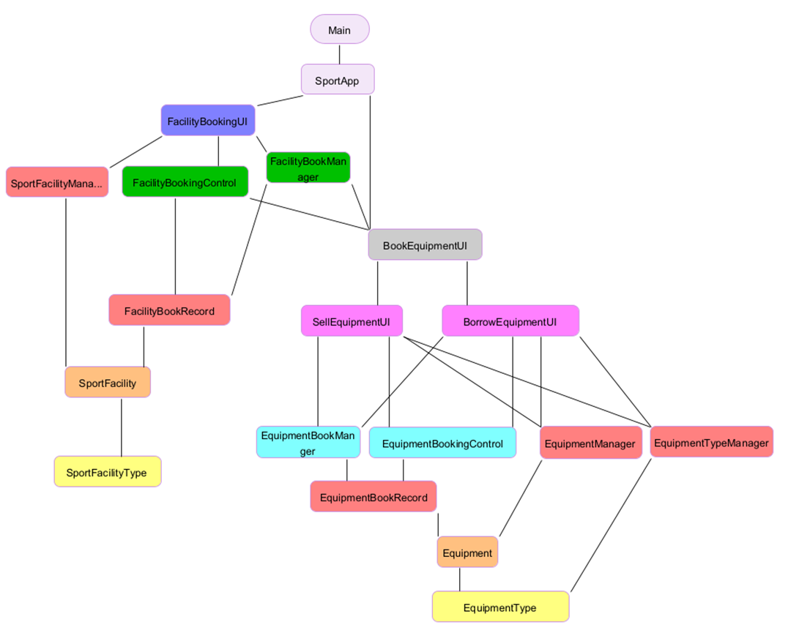
Testing Process
Integration Testing:
FacilityBookUI + FacilityBookingControl + FacilityBookManager +BookEquipmentUI + SellEquipmentUI + BorrowEquipmentUI + EquipmentBookManager + EquipmentBookingControl+ portFacility + Equipment + SportFacilityType + EquipmentType + EquipmentBookRecord + EquipmentManager + EquipmentTypeManager + FacilityBookRecord + SportFacilityManager (Test Stub: N/A)

Slide 59
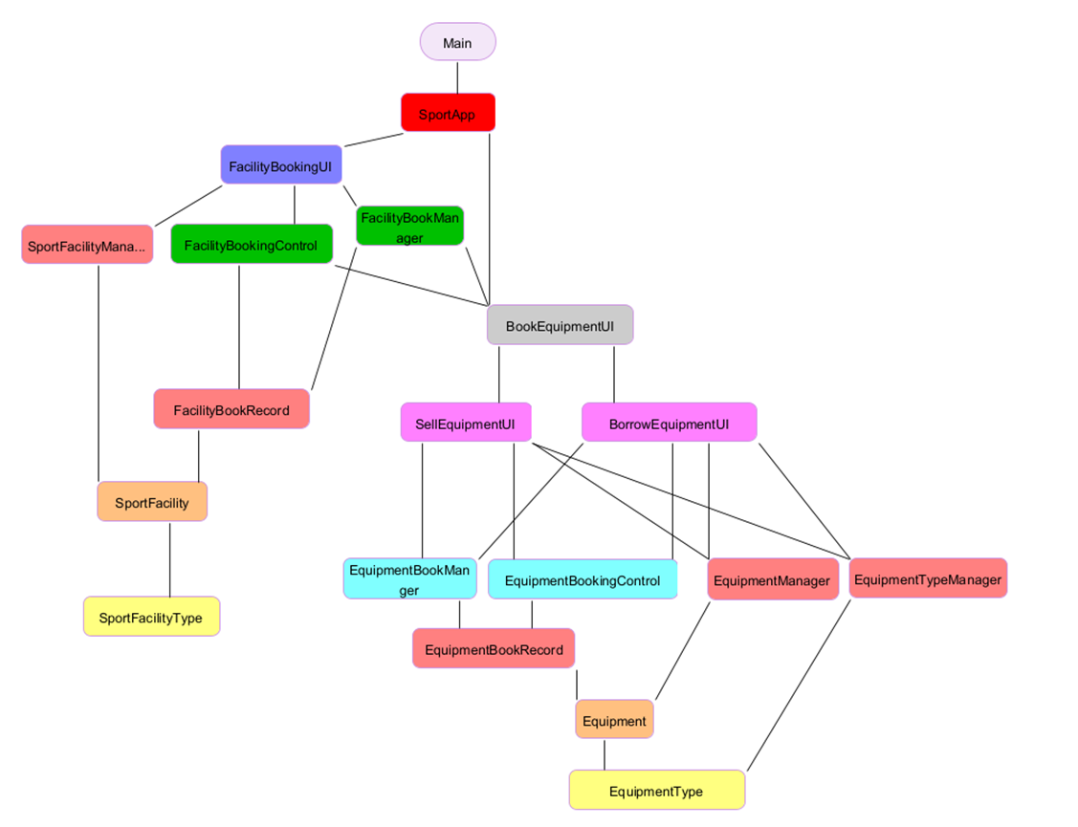
Testing Process
Integration Testing:
SportApp + FacilityBookUI + FacilityBookingControl + FacilityBookManager +BookEquipmentUI + SellEquipmentUI + BorrowEquipmentUI + EquipmentBookManager + EquipmentBookingControl+ portFacility + Equipment + SportFacilityType + EquipmentType + EquipmentBookRecord + EquipmentManager + EquipmentTypeManager + FacilityBookRecord + SportFacilityManager (Test Stub: N/A)

Slide 60
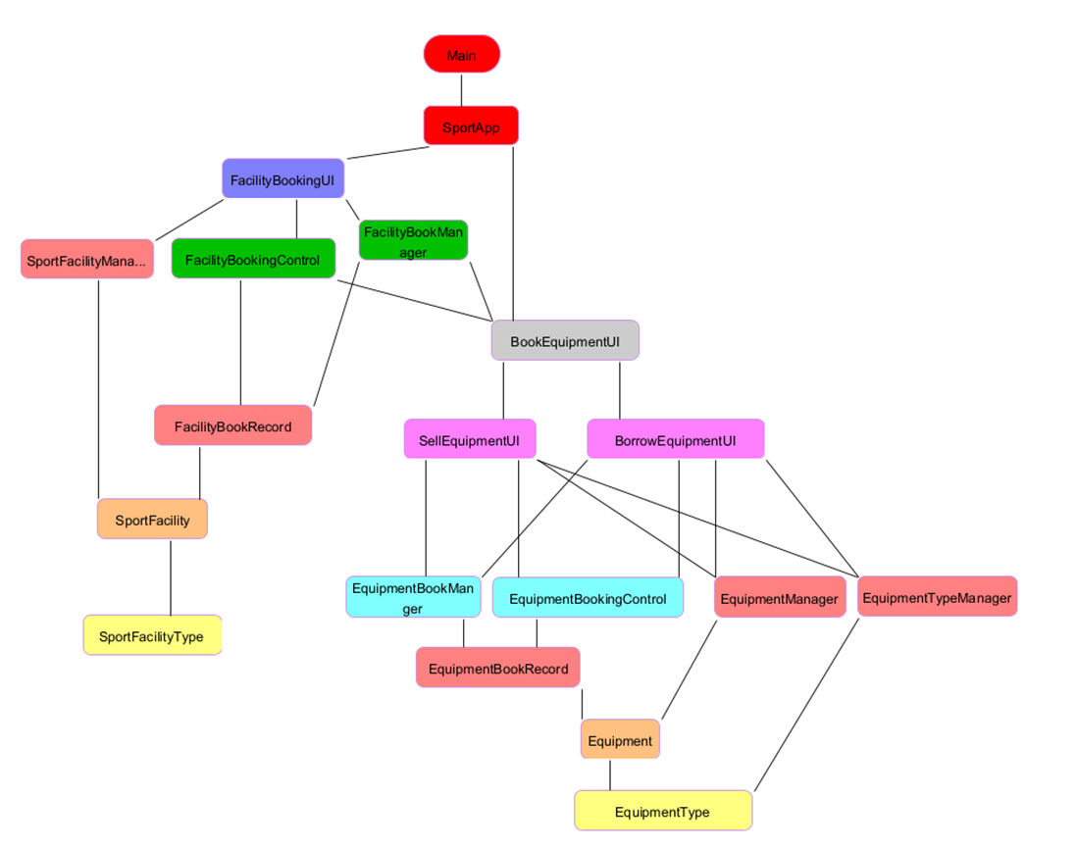
Testing Process
System Testing:
Main + FacilityBookUI + FacilityBookingControl + FacilityBookManager +BookEquipmentUI + SellEquipmentUI + BorrowEquipmentUI + EquipmentBookManager + EquipmentBookingControl+ portFacility + Equipment + SportFacilityType + EquipmentType + EquipmentBookRecord + EquipmentManager + EquipmentTypeManager + FacilityBookRecord + SportFacilityManager (Test Stub: N/A)

Slide 61

Testcases
Example of Unit Test
This class represents a type of sport facility, including:
TypeName: e.g. "Badminton Court"
sportType: e.g. "Badminton", "Basketball"
pricePerHour: hourly rental price
It includes:
A constructor to initialize data
Getter methods to retrieve each field
This is the lowest-level data module in our system, and is the foundation for higher-level logic.

Slide 62


Testcases
We used JUnit to test the SportFacilityType class.
The tests cover:
Normal values and correct getter behavior
Null and empty string handling
Edge cases: negative prices, NaN, infinity
Independence of multiple instances
All tests passed successfully！

Slide 63

Testcases
Example of integration Test
This class integrates multiple components:
SportFacility (facility object)
SportFacilityType (for pricing)
User (booking user)
LocalDate (booking date)
Start and end time slots
Booking status
It includes logic for:
Calculating total price
Generating confirmation message
Comparing booking time slots
This class forms the integration point between facility, user, and time-based booking logic.

Slide 64



Testcases
Integration Test – FacilityBookRecord
These integration tests verify interaction across components:
– testConstructorAndGetters
Confirms object linking and data storage
Verifies time slots and basic structure
Ensures toString() format includes correct info
– testSettersUpdateFacilityAndTimeslotReflectsChanges
Tests dynamic updates of facility, date, time, and status
Ensures changes are reflected in getters and timeslot
– testToStringExactFormat
Verifies full formatting of confirmation message
Ensures correctness of combined facility and time details
These tests confirm that multiple modules work together correctly, not just in isolation.

Slide 65



Test Coverage

Slide 66
Thank you!

